Slide 1
Analysis of generated dataset Filip Krasniqi, Jocelyne Elias and Jérémie Leguay
July 22, 2019

Slide 2
Main points
Visualization of traffic matrix, delay (per link, e2e), load: distribution, time series
Comparison between TCP, UDP
Consideration whether intensities are
Different enough
Representative enough for our needs (eg: High: too many drops?)
Criticalities
TCP retransmission (same or a new packet)
Missing values
T = 0.1s: in this period, especially in case of high, many drops
Choice of T=0.1s for practical reason: data precise enough and otherwise simulation takes more time and memory occupation issue (that limits parallelization)
Techniques
Deletion: removes too many values
Imputation: imprecise for higher values -> may be associated to a packet that drops, and we are approximating with
Mean
Median
Full analysis (learn patterns)
KNN
Expectation – maximization
Add one output for each traffic pair representing whether that packet will drop (probability or 0/1)

Slide 3
Main points
Visualization of traffic matrix, delay (per link, e2e), load: distribution, time series
Comparison between TCP, UDP
Consideration whether intensities are
Different enough
Representative enough for our needs (eg: High: too many drops?)
Criticalities
TCP retransmission (same or a new packet)
Missing values
T = 0.1s: in this period, especially in case of high, many drops
Choice of T=0.1s for practical reason: data precise enough and otherwise simulation takes more time and memory occupation issue (that limits parallelization)
Techniques
Deletion: removes too many values
Imputation: imprecise for higher values -> may be associated to a packet that drops, and we are approximating with
Mean
Median
Full analysis (learn patterns)
KNN
Expectation – maximization
Add one output for each traffic pair representing whether that packet will drop (probability or 0/1)

Slide 4
Main points
Visualization of traffic matrix, delay (per link, e2e), load: distribution, time series
Comparison between TCP, UDP
Consideration whether intensities are
Different enough
Representative enough for our needs (eg: High: too many drops?)
Criticalities
TCP retransmission (same or a new packet)
Missing values
T = 0.1s: in this period, especially in case of high, many drops
Choice of T=0.1s for practical reason: data precise enough and otherwise simulation takes more time and memory occupation issue (that limits parallelization)
Techniques
Deletion: removes too many values
Imputation: imprecise for higher values -> may be associated to a packet that drops, and we are approximating with
Mean
Median
Full analysis (learn patterns)
KNN
Expectation – maximization
Add one output for each traffic pair representing whether that packet will drop (probability or 0/1)

Slide 5
Main points
Visualization of traffic matrix, delay (per link, e2e), load: distribution, time series
Comparison between TCP, UDP
Consideration whether intensities are
Different enough
Representative enough for our needs (eg: High: too many drops?)
Criticalities
TCP retransmission (same or a new packet)
Missing values
T = 0.1s: in this period, especially in case of high, many drops
Choice of T=0.1s for practical reason: data precise enough and otherwise simulation takes more time and memory occupation issue (that limits parallelization)
Techniques
Deletion: removes too many values
Imputation: imprecise for higher values -> may be associated to a packet that drops, and we are approximating with
Mean
Median
Full analysis (learn patterns)
KNN
Expectation – maximization
Add one output for each traffic pair representing whether that packet will drop (probability or 0/1)

Slide 6
Main points
Visualization of traffic matrix, delay (per link, e2e), load: distribution, time series
Comparison between TCP, UDP
Consideration whether intensities are
Different enough
Representative enough for our needs (eg: High: too many drops?)
Criticalities
TCP retransmission (same or a new packet)
Missing values
T = 0.1s: in this period, especially in case of high, many drops
Choice of T=0.1s for practical reason: data precise enough and otherwise simulation takes more time and memory occupation issue (that limits parallelization)
Techniques
Deletion: removes too many values
Imputation: imprecise for higher values -> may be associated to a packet that drops, and we are approximating with
Mean
Median
Full analysis (learn patterns)
KNN
Expectation – maximization
Add one output for each traffic pair representing whether that packet will drop (probability or 0/1)

Slide 7
Main points
Visualization of traffic matrix, delay (per link, e2e), load: distribution, time series
Comparison between TCP, UDP
Consideration whether intensities are
Different enough
Representative enough for our needs (eg: High: too many drops?)
Criticalities
TCP retransmission (same or a new packet)
Missing values
T = 0.1s: in this period, especially in case of high, many drops
Choice of T=0.1s for practical reason: data precise enough and otherwise simulation takes more time and memory occupation issue (that limits parallelization)
Techniques
Deletion: removes too many values
Imputation: imprecise for higher values -> may be associated to a packet that drops, and we are approximating with
Mean
Median
Full analysis (learn patterns)
KNN
Expectation – maximization
Add one output for each traffic pair representing whether that packet will drop (probability or 0/1)

Slide 8
Main points
Visualization of traffic matrix, delay (per link, e2e), load: distribution, time series
Comparison between TCP, UDP
Consideration whether intensities are
Different enough
Representative enough for our needs (eg: High: too many drops?)
Criticalities
TCP retransmission (same or a new packet)
Missing values
T = 0.1s: in this period, especially in case of high, many drops
Choice of T=0.1s for practical reason: data precise enough and otherwise simulation takes more time and memory occupation issue (that limits parallelization)
Techniques
Deletion: removes too many values
Imputation: imprecise for higher values -> may be associated to a packet that drops, and we are approximating with
Mean
Median
Full analysis (learn patterns)
KNN
Expectation – maximization
Add one output for each traffic pair representing whether that packet will drop (probability or 0/1). Still represent the other

Slide 9
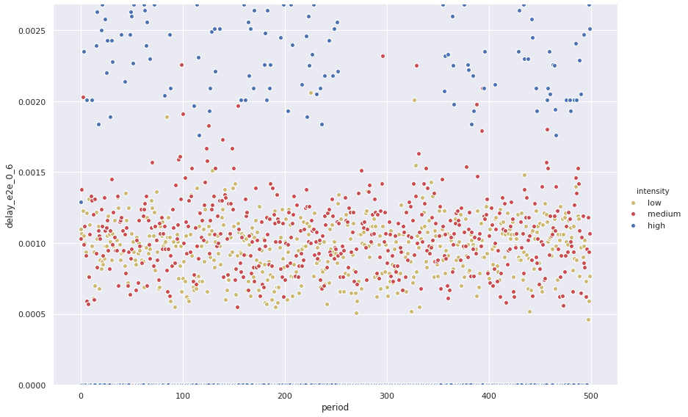
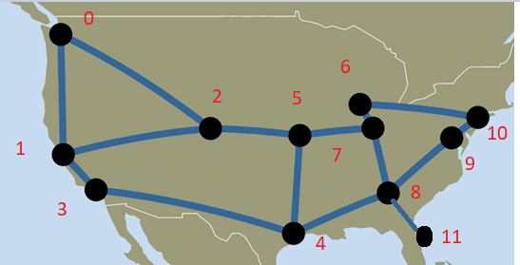
KNN for imputation when building dataset
Mark values where 0 packets are sent
Search for closest K (eg: 10) values that are not marked according to TM
Average among the K values OR median value (depends on variance)
Figure: evolution over the periods
of e2e delay for low, medium, high cases.
Details on the traffic:
Application: TCP
OD: 0—6
Path: 0—2—5—7—6

